Slide 1

Cyber Risk from Theory to Practice

Slide 2
Jiorgos Miskakis, EvidentScientific EMEA CISO ISACA CISM,CISA,CDPSE,CRISC, PECB ISO27K Auditor&Implementer, ITIL v3
The company produces:
Microscopes
Endscopes
for industrial or health science usage

Slide 3
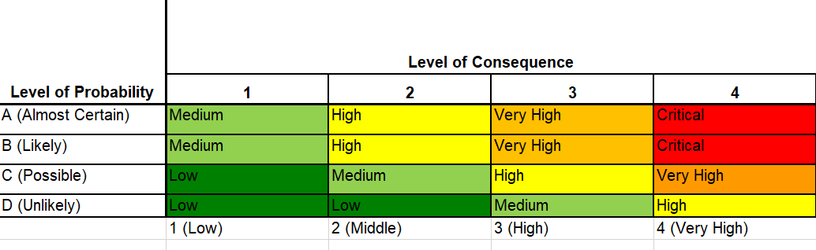
A qualitative risk assessment:
A long questionnaire with information security ISMS questions or XYZ Framework
Likelihood and Impact/Consequences are subjective given
Treatment plan includes high level statements

Slide 4




Which leads to:
Mostly to Staffing need
Questionable
Lengthy ….. discussions

Slide 5

A combined approach based on controls, efficiency and risk scenarios

Slide 6
Triage example 1
Confidentiality
5-Top Secret, e.g PII, Intellectual Property, blueprints
4-Confidential
Integrity
5-It requires the strictest controls to prevent unauthorized access, modification, or tampering
3-Data at this level is less sensitive and can tolerate a certain degree of modification or inadvertent errors. E.g build process
Availability
5-Max. 2h outage
3-Up to 8h
1-Public
1-Is not relevant, e.g synthetic random data
1-Can remain down till someone will decide otherwise
4-Max. 4h outage
2-Up to 12h

Slide 7
Triage example 2
Confidentiality
5-Top Secret, e.g PII, Intellectual Property, blueprints
4-Confidential
Integrity
5-It requires the strictest controls to prevent unauthorized access, modification, or tampering
3-Data at this level is less sensitive and can tolerate a certain degree of modification or inadvertent errors. E.g build process
Availability
5-Max. 2h outage
1-Public
1-Is not relevant, e.g synthetic random data
Distribution
5-Globally locations, multiple admins
3-Less than 3 countries, multiple users
1-Small userbase in one single country
4-Max. 4h outage
3-Up to 8h
2-Up to 12h
1-Can remain down till someone will decide otherwise

Slide 8

Framework Design Principles
Context-Based Scenarios – Tailor risks to business needs.
Asset Prioritization (Triage) – Identify and classify critical assets.
Control Mapping
Efficiency in Controls – Measurable controls (e.g., patch cadence, response time).
Risk Categorization

Slide 9
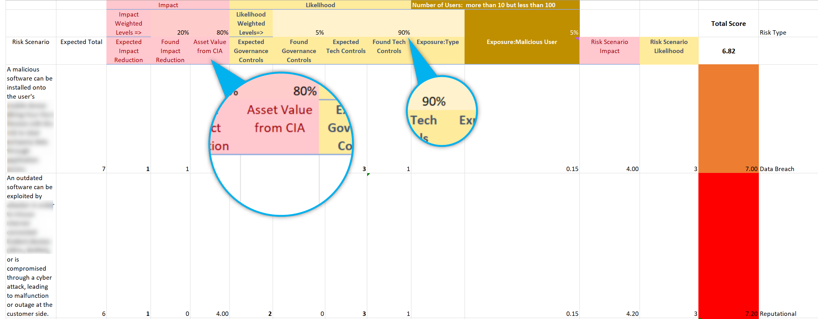
Execute (example)
Validate Scenario Relevance
Consider always the value of the asset
Governance controls can reduce the likelihood of things going wrong.

Slide 10
Key Takeaways
Simplifies interactions with intuitive, accessible questions
User-Friendly
Time Considerations
Complexity Is Hidden
Broad Applicability
Tech Agnostic

Slide 11
Key Takeaways
Scenario creation is time consuming and needs feedback from multiple stakeholders
User-Friendly
Time Considerations
Complexity Is Hidden
Broad Applicability
Tech Agnostic

Slide 12
Key Takeaways
Providing the enduser an easy to understand story
Controls statements, or mapping to various Security frameworks can be done in background
User-Friendly
Time Considerations
Complexity Is Hidden
Broad Applicability
Tech Agnostic

Slide 13
Key Takeaways
The framework can be applied from spreadsheets to web Uis and it is not tighten to a specific product or vendor
User-Friendly
Time Considerations
Complexity Is Hidden
Broad Applicability
Tech Agnostic

Slide 14


Thank you!
Jiorgos Miskakis
https://www.linkedin.com/in/miskakis/
ISACA CISM,CISA,CDPSE,CRISC,
PECB ISO27K Auditor&Implementer,
ITIL v3

